Slide 1

The Fourth Hour!
Welcome to…

Slide 2
Introduction
Welcome to the Fourth Hour!
Name
Professor
A fun fact about you

Slide 3
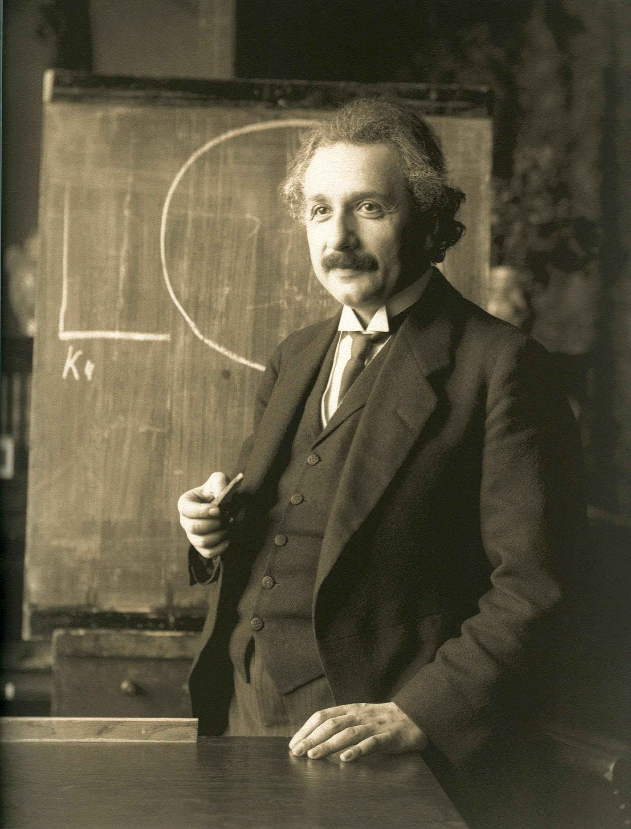
“Anyone who has never made a mistake has never tried anything new.”

Slide 4
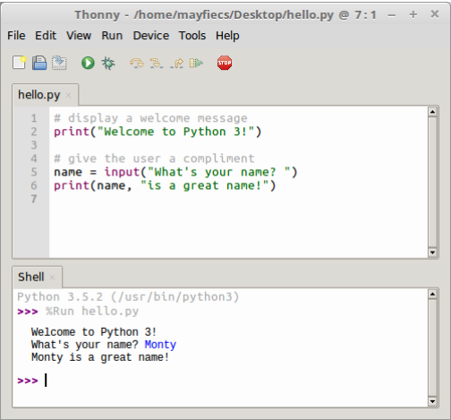
Where is the Shell window?

Slide 5
Where is the Shell window?
Where is the Editor window?

Slide 6
Where is the Shell window?
Where is the Editor window?
What symbol is at the start of a line (in the editor) not displayed as output?

Slide 7
Where is the Shell window?
Where is the Editor window?
What symbol is at the start of a line (in the editor) not displayed as output?
What is the purpose of the blank lines in the Editor window?

Slide 8
Review
Login to Socrative at https://b.socrative.com/login/student/
Use code 4thHour149

Slide 9
Question
What is the difference between the shell and the editor?
They are the same thing.
The editor is used to write more complex programs
The shell is used to write more complex programs
You run programs in the editor.

Slide 10
Question
What is the difference between the shell and the editor?
They are the same thing.
The editor is used to write more complex programs
The shell is used to write more complex programs
You run programs in the editor.

